Slide 1
Capstone -3 | Presentation
World Temperature | NewYork

Slide 2
Problem Identification
World Temperature dataset needs to find better ways to predict the pattern of the temperature in their records.
In this dataset 2906327 records with 8 columns were taken for this project.
We need to extract New York temperature records from the exist one.
Need to analyse World temperature as well as New York temperature datas for the EDA clarity.
We need to find the pattern of New York city temperature.

Slide 3
Recommendation and key findings
The solution for the business problem was a general one of modeling to predict the temperature pattern of New York .
Analyze world temperature scenarios.
Using our time series LSTM model to gain insight into the temperature what could be, and how that might change under various scenario.
Using Arima model visualize the prediction

Slide 4
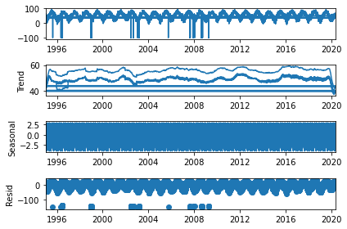
Seasonal Decompose

Slide 5
Sequential Model
Model: "sequential“
Layer (type) Output Shape Param #
=================================================================
lstm (LSTM) (None, 20, 64) 16896
_________________________________________________________________
lstm_1 (LSTM) (None, 32) 12416
_________________________________________________________________
dense (Dense) (None, 1) 33
=================================================================
Total params: 29,345
Trainable params: 29,345
Non-trainable params: 0
___________________________

Slide 6
Seasonal ARIMA Model
AvgTemperature
2020-05-31 | 47.726154
2020-06-30 | 63.853862
2020-07-31 | 72.567823
2020-08-31 | 71.177142
2020-09-30 | 65.210730

Slide 7
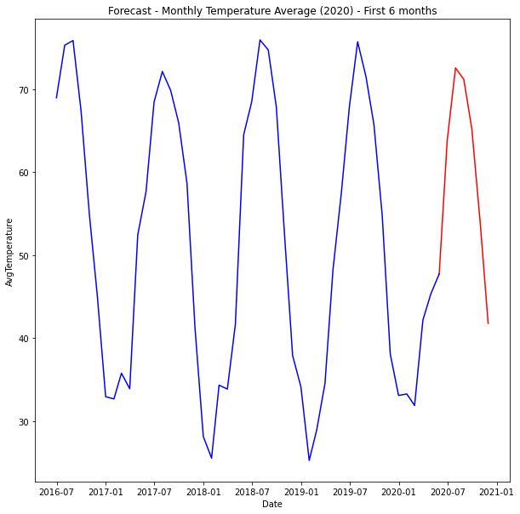
Plotting Results

Slide 8
Summary and Conclusion
The solution for the business problem was a general one of modeling to predict the temperature pattern of New York .
Analyze world temperature scenarios.
Using our time series LSTM model to gain insight into the temperature what could be, and how that might change under various scenario.
Using Arima model and visualize the prediction

